Slide 1
DATA ANALYSIS FOR CHELSEA TEAM REPLACEMENT POLICIES
CODEKOROS
2024

Slide 2
TABLE OF CONTENTS
01
02
03
THE PROBLEM
Why replacement of players is needed
SOLUTION
Transformation of data into insights
IMPACT
The solution

Slide 3
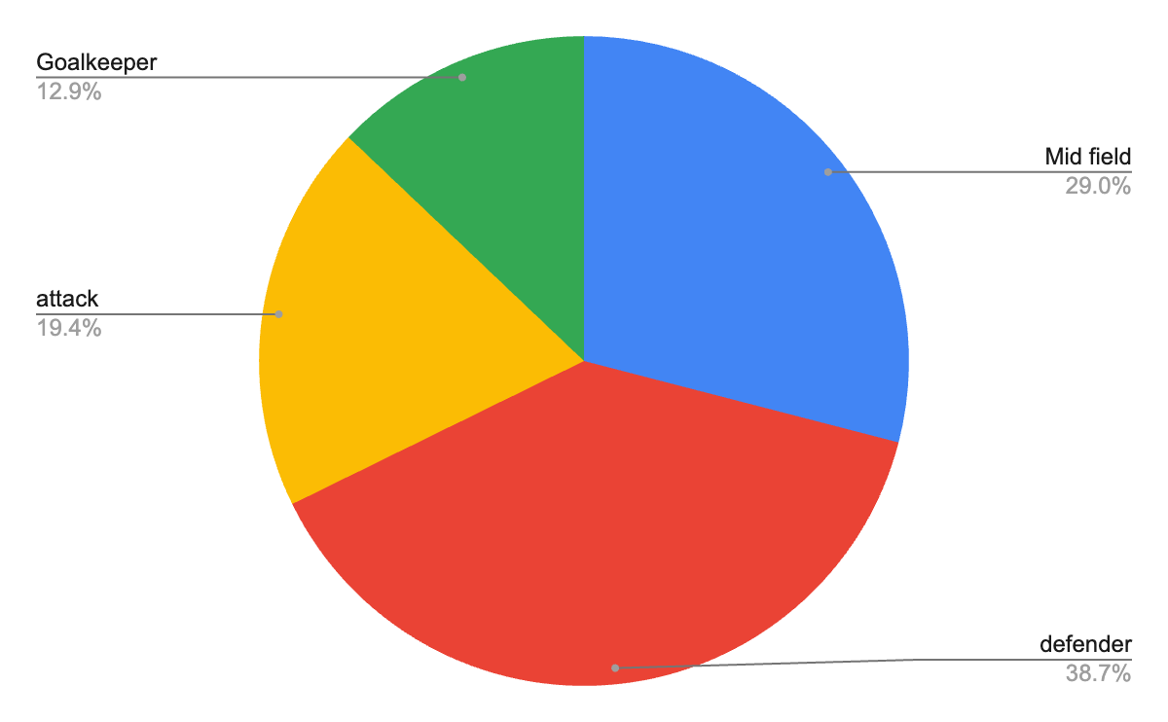
Current lineup
CODEKOROS
The current line has a total of 37 players out of which some are underperforming players,Thus we have to perform a analysis on the player data

Slide 4
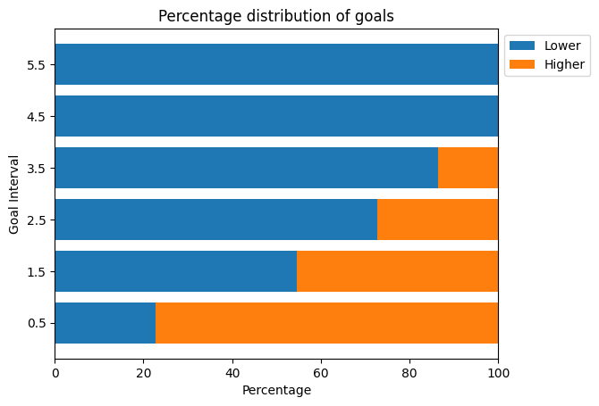
According to this distribution, The Chelsea team is scoring goals in the first half but is conceding in the 2nd half, thus we need work on defensive strategy
CODEKOROS

Slide 5
Since Nicolas is out of the game we have-
CODEKOROS
150000000 £ +35000000 £ =
185000000£

Slide 6
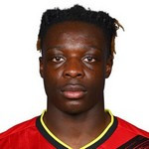
Purchase 1
Jeremy Doku
appearances | Goals | Assists | Yellow card | Red card | minutes played
13 | 2 | 5 | 3 | - | 870’
Jeremy Doku
Midfielder
65000000
star midfielder
Average midfield player
appearances | Goals | Assists | Yellow card | Red card | minutes played
- | 0.43 | 0.45 | 0.43 | 0.03 | 870’
Remaining money:120000000

Slide 7
Purchase 1
Jeremy Doku
Midfielder
65000000
star midfielder
Remaining money:120000000

Slide 8

Purchase no. 2
Diago dalot
appearances | Goals | Assists | Yellow card | Red card | minutes played
20 | 1 | 1 | 4 | - | 1.734
Diago Dalot
(defender)
35000000
Can be a great replacement for Reece James.
Thus we sell him
Reece James.
appearances | Goals | Assists | Yellow card | Red card | minutes played
8 | - | 1 | - / 1 / - | - | 390’
Remaining money:135000000

Slide 9
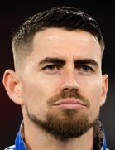
Purchase no. 3
Jorginho
(defensive mid )
15000000
.
Helps in defense and concede goals
Remaining money:120000000

Slide 10

Purchase no. 4
Pablo Sarabia
12000000
attacking midfielder
.
Remaining money:108000000

Slide 11
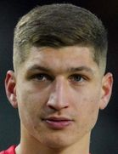
Purchase no. 5
Mac Allister
mid fielder
45 million
Remaining money:63000000

Slide 12
The Impact: The players we have selected create chances for a goal, the mid fielders can also strike but also defend at the same time.

Slide 13
THANKYOU!
DO YOU HAVE ANY QUESTIONS?

